Slide 1

Lecture 7
Socket.io

Slide 2

A G E N D A
Introduction to Socket.io
Why Socket.io
Applications of Socket.io
Basic operations of Socket.io
How communication works using Socket.io
Notes:
In this chapter, we will talk about the concept of keys, and the two types of keys in SQL databases, namely Primary keys and foreign keys. Then we will deep dive into the 3 types of table relationships in SQL databases.

Slide 3
Introduction to Socket.io
Definition: Socket.IO is a real-time communication library based on Node.js that enables bidirectional communication between the browser and the server.
Features:
Node.js, mobile devices, etc.
Cross-browser compatibility: Supports real-time communication needs for different browsers, including older versions.
Bidirectional communication: Supports bidirectional data transmission, enabling real-time data exchange.
Fault tolerance and reconnection: Includes fault tolerance and automatic reconnection mechanisms, maintaining communication even when network connections are interrupted.

Slide 4
Why Socket.io
Most of the applications on Internet today are based on Client-Server architecture. A client is someone who requests something from a Server. A Server, based on the request, responds with appropriate results.
These two entities are completely different from each other because of the nature of tasks they perform. ﻿A browser is a perfect example of client application. Clients on browsers usually communicate to Servers via HTTP requests and responses. The problem with this communication is that either a request or a response can be sent at a time. For understanding, think of it as a half-duplex link.
Also, HTTP headers contain lots and lots of redundant information which is useless once a connection between client and server is made. Sockets on the other hand work on transport layer of Network Stack. There are not many redundant fields thus increase the efficiency of information transfer over web.

Slide 5
Applications of Socket.io
Instant messaging application: Socket IO can be used to build instant messaging applications, enabling real-time messaging and communication.
Real time collaborative application: In collaborative editing, real-time whiteboard, and other scenarios, multiple users can simultaneously edit and view the same document or canvas.
Real time gaming application: Socket IO can support real-time gaming applications, enabling real-time interaction and data exchange among multiple players.
Real time monitoring application: through Socket IO， It can collect and display various monitoring data in real-time, such as server load, network traffic, etc.

Slide 6
Basic operations of Socket.io
Installation and Introduction:
Server:
Client: A standalone build of the client is exposed by default by the server at /socket.io/socket.io.js. Otherwise, it can also be served from any of the CDN providers. To use it from Node.js, install it via this command:
$ npm install --save socket.io
$ npm install --save socket.io-client

Slide 7
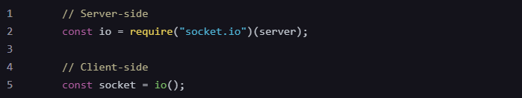
Basic operations of Socket.io
Creating a Socket
Use the io.listen() method to create a Socket.
Client-side: Use the io() method to create a Socket.

Slide 8
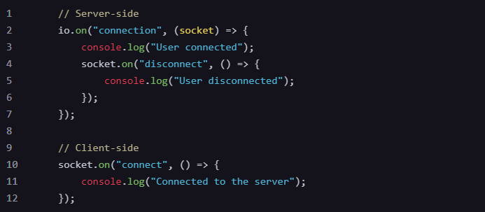
Basic operations of Socket.io
Binding Event Listeners
Socket.IO provides various events such as connect, disconnect, message, etc.
By listening to these events, real-time communication with clients can be achieved.

Slide 9
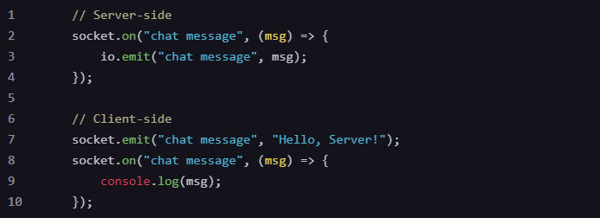
Basic operations of Socket.io
Sending and Receiving Data
Use the emit method to send data and the on method to receive data.

Slide 10
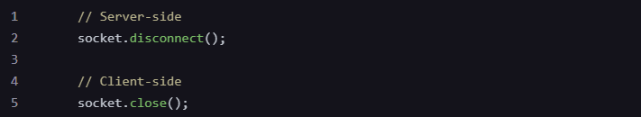
Basic operations of Socket.io
Disconnecting a Connection
When communication is no longer needed, the connection can be manually disconnected.

Slide 11
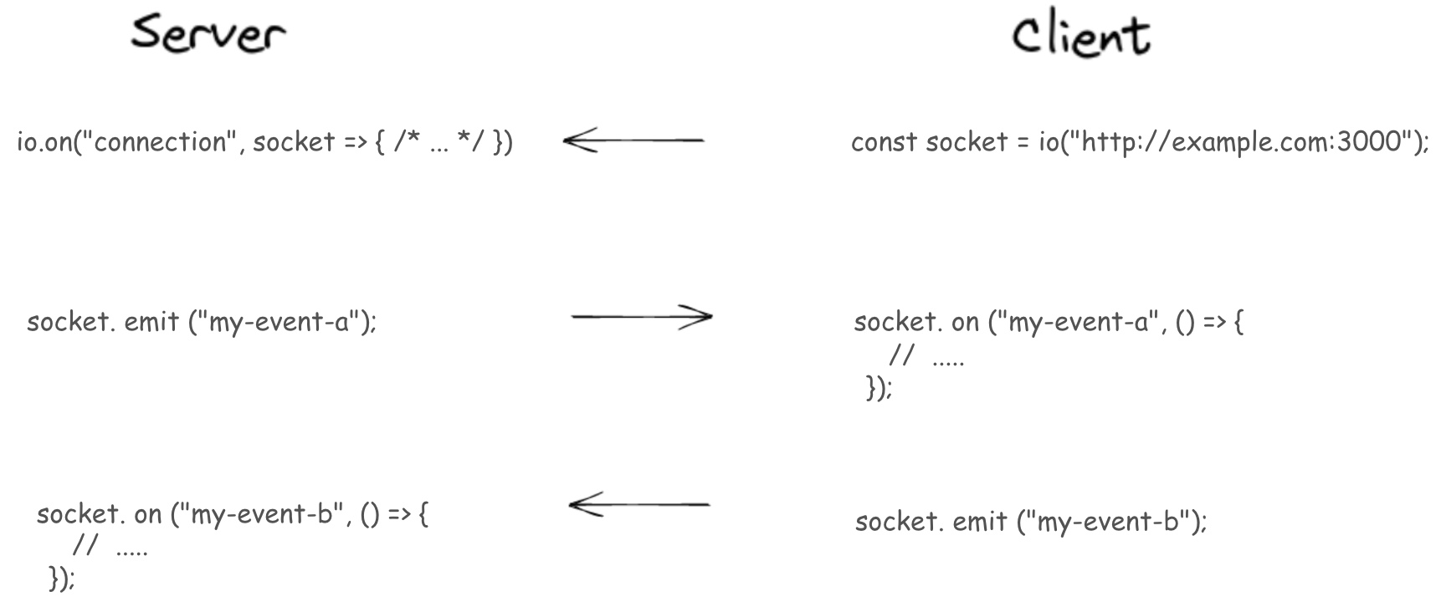
Basic operations of Socket.io
Socket.IO allows servers and clients to communicate in real time. To use Socket.IO it must be integrated on both the server and client.

